Slide 1

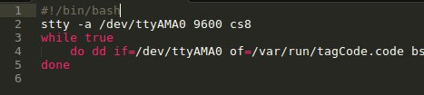

Interfacing with an RFID reader
RFID reader uses 9600baud UART
RPi has a UART – no need for an RS232-USB converter
Solutions – the main server runs Java
  Bash script, high level and requires filesystem work
  C – low level, very configurable, more process-oriented, less script oriented, blocking on devices is easier
IPC must then be used, a FIFO was chosen

